Slide 1

Mambo No. 5: A Little Bit of Kotlin in My Life, A Little Bit of Scala 3 in My Mind
Anthony Accioly

Slide 2
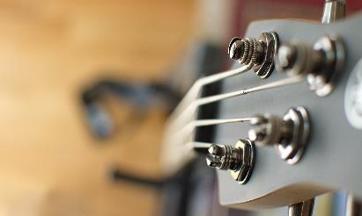



Agenda
Java & Kotlin & Scala 3
Main: Let’s start from the start
Enums
Extension methods
Value classes & Aliases
Kotlin & Scala 3 (Encore)
https://github.com/aaccioly-demos/mambo-no5

Slide 3
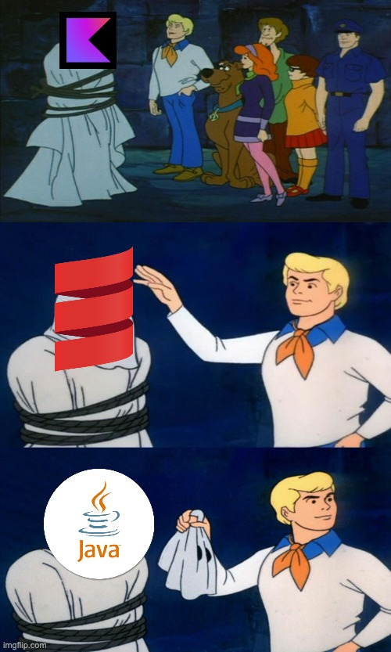
Java & Kotlin & Scala 3
Something about me
Something about you
Something about this talk
Something about the languages

Slide 4

May 23rd, 1995

Slide 5




timeline
1995-1996
2001-2004
2016
2021
2023
3

Slide 6
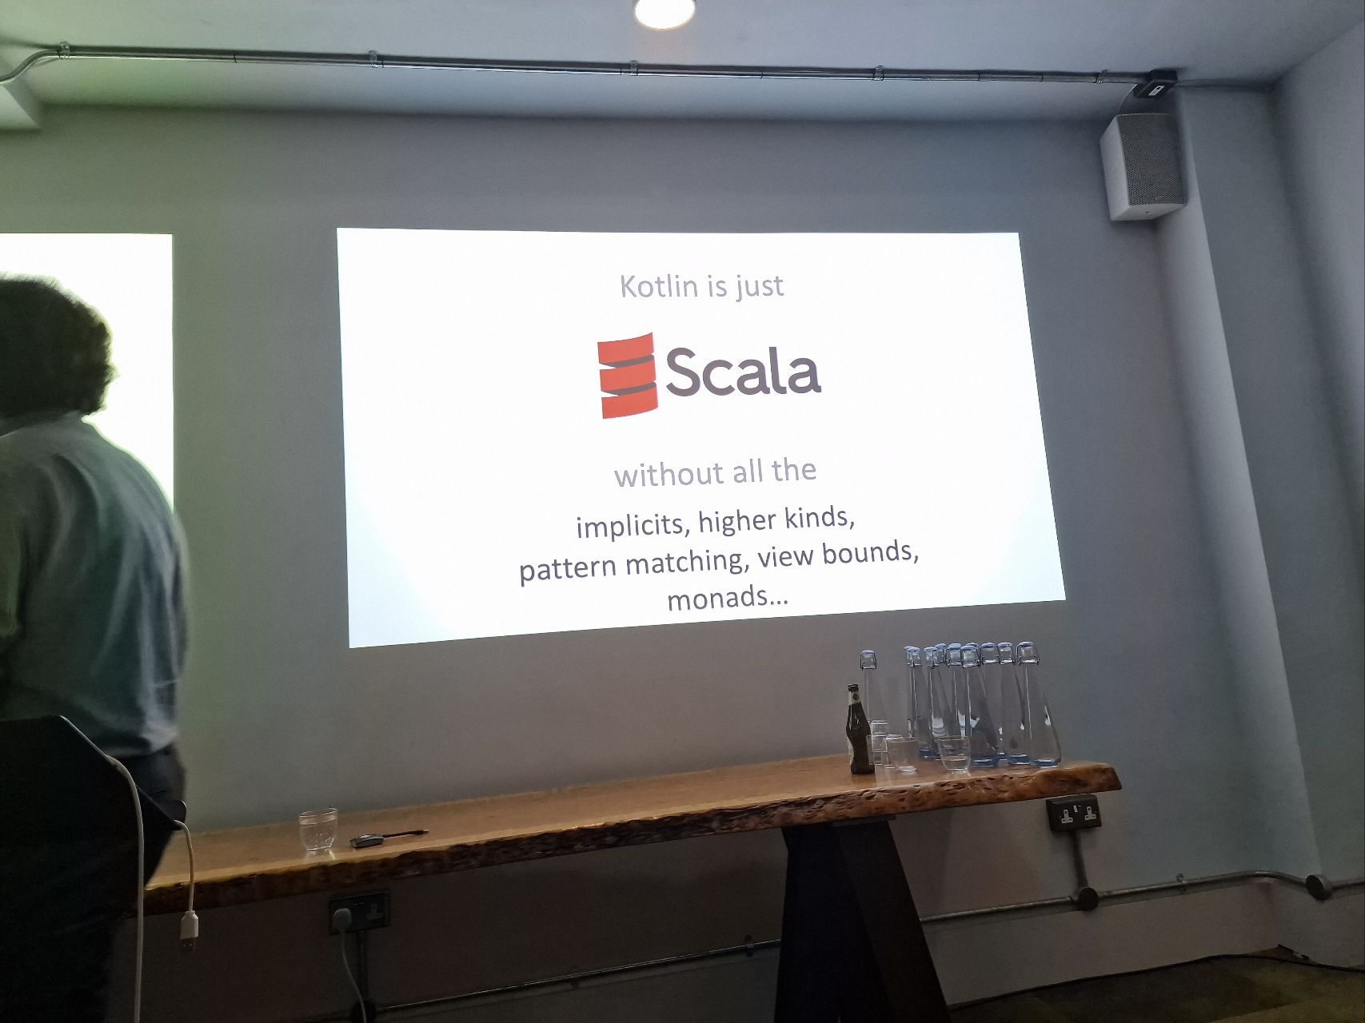
KOTLIN is…
Fist and foremost a pragmatic language
Great tooling
Gaining popularity in the industry
Not restricted to Android
Source Talks: On Kotlin #5 with Andrey Breslav – Shoulders of giants

Slide 7
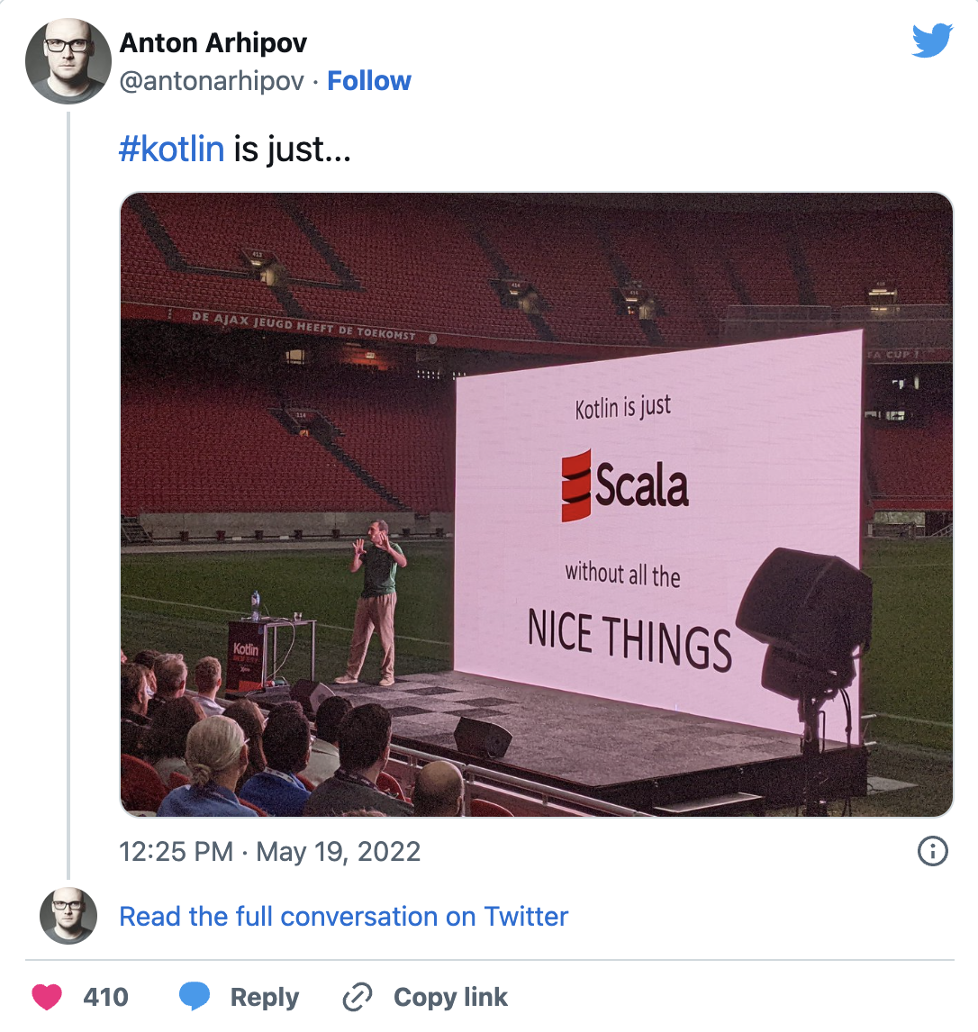
Scala 3 is…
Powerful
Faster than Scala 2
Simpler than Scala 2
Still finding its place in the industry
https://twitter.com/antonarhipov/status/1527249040244723713

Slide 8


Topic one
Subtitle

Slide 9
chart

Slide 10
table
 | Category 1 | Category 2 | Category 3 | Category 4
Item 1 | 4.5 | 2.3 | 1.7 | 5
Item 2 | 3.2 | 5.1 | 4.4 | 3
Item 3 | 2.1 | 1.7 | 2.5 | 2.8
Item 4 | 4.5 | 2.2 | 1.7 | 7

Slide 11

The way to get started is to quit talking and begin doing.
Walt Disney

Slide 12




team
Name
Name
Name
Name
Title
Title
Title
Title

Slide 13
content
Subtitle
Subtitle
Add text, images, art, and videos.
Add transitions, animations, and motion.
Save to One Drive, to get to your presentations from your computer, tablet, or phone.
Add text, images, art, and videos.
Add transitions, animations, and motion.
Add text, images, art, and videos.
Add transitions, animations, and motion.
Save to One Drive, to get to your presentations from your computer, tablet, or phone.
Add text, images, art, and videos.
Add transitions, animations, and motion.

Slide 14
Content 2
Subtitle
Subtitle
Subtitle
Add text, images, art, and videos.
Add transitions, animations, and motion.
Save to One Drive, to get to your presentations from your computer, tablet, or phone.
Add text, images, art, and videos.
Add transitions, animations, and motion.
Add text, images, art, and videos.
Add transitions, animations, and motion.
Save to One Drive, to get to your presentations from your computer, tablet, or phone.
Add text, images, art, and videos.
Add transitions, animations, and motion.
Add text, images, art, and videos.
Add transitions, animations, and motion.
Save to One Drive, to get to your presentations from your computer, tablet, or phone.
Add text, images, art, and videos.
Add transitions, animations, and motion.

Slide 15
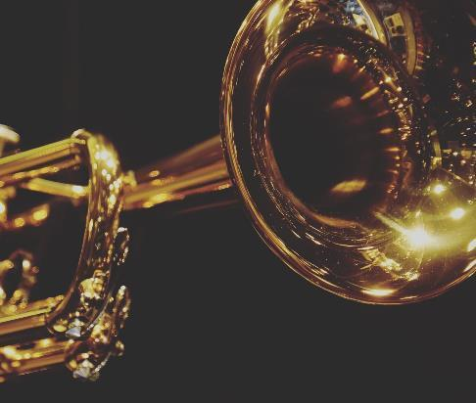
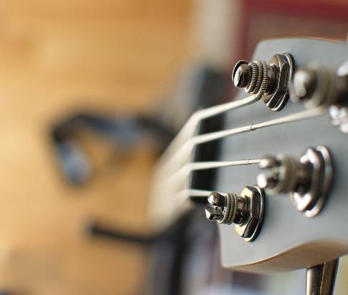
KOTLIN & SCALA 3
Some of the best features of Java, Kotlin & Scala 3 are converging
By design Scala is the more powerful language
Kotlin is a cool language with some nice features of its own OOB (E.g., Null safety, Continuations / Coroutines)
It’s relatively easy to transition from Scala to Kotlin
Choice is a good thing

Slide 16







Questions?
https://www.linkedin.com/in/aaccioly
@anthony@mastodon.accioly.dev
https://stackoverflow.com/users/664577
https://accioly.dev
a.accioly at protonmail.com
Mambo No. 5: A Little Bit of Kotlin in My Life, A Little Bit of Scala 3 in My Mind © 2023 by Anthony Accioly is licensed under CC BY-SA 4.0
https://github.com/aaccioly-demos/mambo-no5

